Slide 1

AABER Analytics
Investigating Crime Patterns in Austin, TX

Slide 2
Objective and Data Source Used
We chose to analyze the public safety (data catalog) more precisely the crime reports around Austin, Texas over the years.
On exploring the City of Austin - Public Data Portal and the available data sources, the Crime Reports dataset looked interesting and has larger scope on analysis and visualization.
We decided on Crime Reports specifically towards Alcohol and Marijuana use. we analyzed them and made some useful visualization related to Location and time.

Slide 3
How do the number and types of crimes involving alcohol and marijuana occurring throughout Austin vary with respect to location and time?
Hypothesis:
Alcohol-related crimes are more likely to occur in the same areas as marijuana-related crimes.
Alcohol-related crimes are more likely to occur at different times of day and days of week than marijuana-related crimes.
Day of week.

Slide 4
How does crime frequency and type for alcohol and marijuana-related offenses differ by Zip-code?
Hypothesis:
There are more crimes in the downtown zip codes? Look at the types of crimes. I imagine distribution vs. possession will be different.
In the scope of our research we did not do that. We will if we have further time and resources.

Slide 5




Clean-up Process
Locations outside of Austin
Selecting only relevant Marijuana and Alcohol Crime Types
NaNaNaNaNaNaN values
Crimes reported before Occurrence

Slide 6
BEFORE

Slide 7

Data Categories | Number of Cases
Possession of Marijuana | 37,634
Poss(ession*) of Synthetic Marijuana | 1,023
Del(ivery*) Marijuana | 221
Del(ivery*) Synthetic Marijuana | 116
Manf(facturing*) Controlled Sub(stance*)/Syn(thetic*) Narc(otic*) | 20
Manf(facturing*) Synthetic Marijuana | 1
DWI | 72,892
DWI 2nd | 10,202
DWI .15 BAC or above | 6,036
DWI – Drug Recognition Expert | 1,206
DWI - Child Passenger | 1,088
VOCO (Violation of City Ordinance*) - Alcohol Consumption | 9708
Poss(ession*) of Alcohol - Age 17 to 20 | 3109
Poss(ession*) of Alcohol - Age 16 & under | 376
Del(ivery*) of Alcohol to Minor | 131
Poss(ession*) of Drug Paraphernalia | 35,288
Poss(ession*) Controlled Sub(stance*)/Syn(thetic*) Narcotic | 1,630

Slide 8
Data Categories Cont.. | Number of Cases Cont..
Poss(ession*) Controlled Sub(stance*)Narcotic | 35,054
Driving while Intox(icated*)/Felony | 4,401
Liquor Law Violation/Other | 2,748
Obtain Controlled Sub(stance*) by fraud | 1,442
DUI - Age 17 to 20 | 1,417
Tobacco Viol(ation*) - Under Age 17 | 708
Tobacco Viol(ation*) - Age 17 | 333
Crash/Intoxication Assault | 366
Del(ivery*) Controlled Sub(stance*)/Syn(thetic*) Marijuana | 320
Making Tobacco Avail(able*) to Minor | 247
Del(ivery*) Controlled Sub(stance*)/Other | 184
DUI - Age 16 and Under | 124
Manf(facturing*) Controlled Sub(stance*) – Other | 110
Distr(ibute*) Harmful Material Minor | 104
Dang(erous*) Drug Viol(ation*) – Other | 71
Crash/Intox(icated*) Manslaughter | 66
Obtain Dang(erous*) Drug By Fraud | 66

Slide 9
Data Categories Cont.. | Number of Cases Cont..
Expired-Att(empt*) Obt(ain*) Cont(rolled*) Sub(stance*) Fraud | 65
Controlled Sub(stance*) Viol(ation*) - Other | 48
Boating While Intoxicated | 41
Del(ivery*) of Dang(erous*) Drug | 15
Expired-Att(empt*) Ob(tain*) Dang(erous*) Drug Fraud | 10
Sale of Liq(uor*) Without Permit | 7
BWI (Boating While Intoxicated)-Expired Use 2110 | 7
Tobacco Viol(ation) - Under Age 21 | 5
Poss(ession*) of Liq(uor*) on School Property | 3
Sale of Liq(uor*) In Prohib(ited*) Area | 2
Sale of DXM (Dextromethorphan - medication used as cough suppressant) to Minor | 1
Illegal Transportation of Liq(uor*) | 1

Slide 10
AFTER

Slide 11
Data Categories | Number of Cases
Possession of Marijuana | 37,634
Poss(ession*) Synthetic Marijuana | 1023
Del(ivery*) Marijuana | 221
Del(ivery*) Synthetic Marijuana | 116
Manf(facturing*) Synthetic Marijuana | 1
DWI | 72,892
DWI 2nd | 10,202
DWI .15 BAC (Blood Alcohol Content*) or above | 6,036
DWI - Drug Recognition Expert | 1,206
DWI - Child Passenger | 1,088
VOCO (Violation of City Ordinance*) - Alcohol Consumption | 9,708
Poss(ession*) of Alcohol - Age 17 to 20 | 3,109
Poss(ession*) of Alcohol - Age 16 & under | 376
Del(ivery*) of Alcohol to Minor | 131
Driving while Intox(icated*)/Felony | 4,401
Liquor Law Violation/Other | 2,748

Slide 12
Data Categories | Number of Cases
DUI - Age 17 to 20 | 1,417
Crash/Intoxication Assault | 366
Del(ivery*) Controlled Sub(stance*)/Syn(thetic*) Marijuana | 320
DUI - Age 16 and Under | 124
Crash/Intox(icated*) Manslaughter | 66
Boating While Intoxicated | 41
Sale of Liq(uor*) Without Permit | 7
BWI (Boating While Intoxicated)-Expired Use 2110 | 7
Poss(ession*) of Liq(uor*) on School Property | 3
Sale of Liq(uor*) In Prohib(ited*) Area | 2
Illegal Transportation of Liq(uor*) | 1

Slide 13

Data Exploration
We chose to examine the City of Austin Open Data Portal, because it has large, clean, well documented datasets, and the data is relevant to members of the team.
We looked at traffic incident data, crime reports data, police data, ....
Specifically, we were interested in understanding how the number and types of crimes vary with respect to location and time and focused on two types of crimes:
Alcohol-Related Crime
Marijuana-Related Crimes

Slide 14
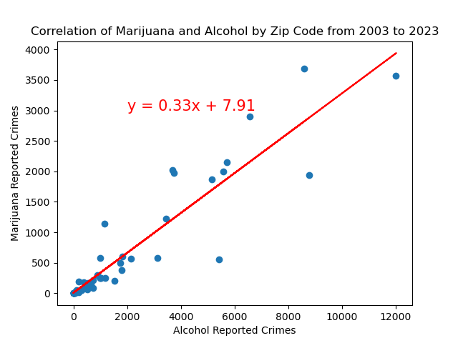
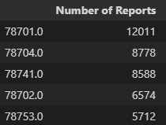
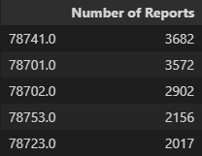
Top Zip Codes for Alcohol
Top Zip Codes for Marijuana
The r-value is: 0.86
The correlation between both is 0.93

Slide 15
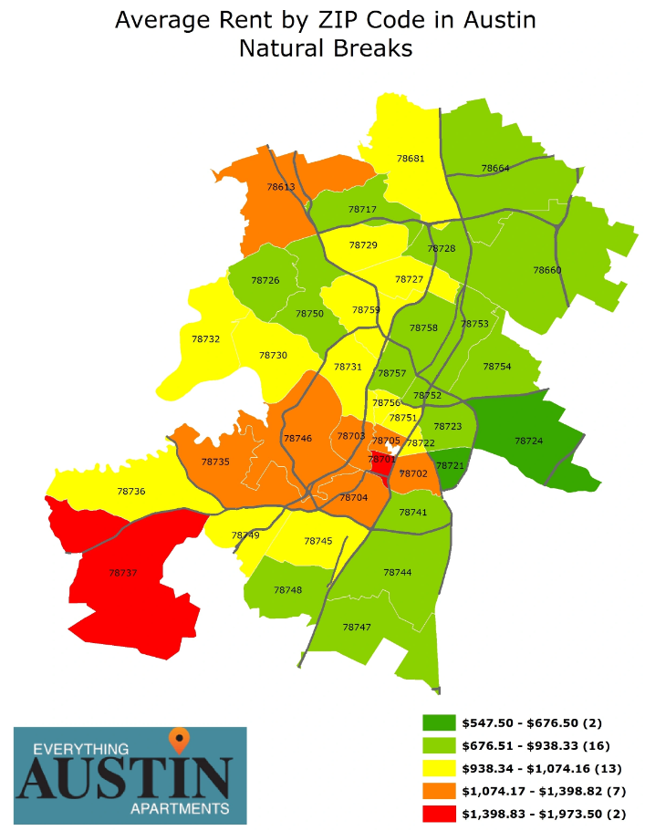
Top Zip Codes for Alcohol
Top Zip Codes for Marijuana

Slide 16

Final Data Analysis

Slide 17
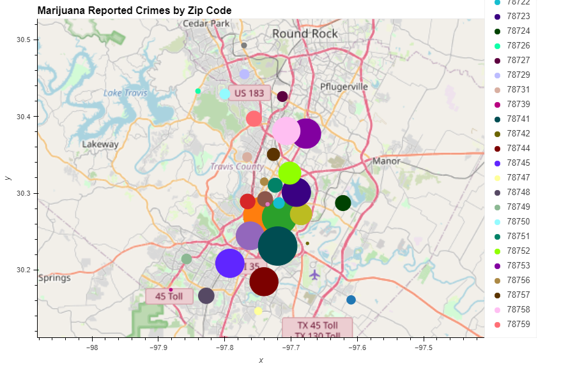

Slide 18
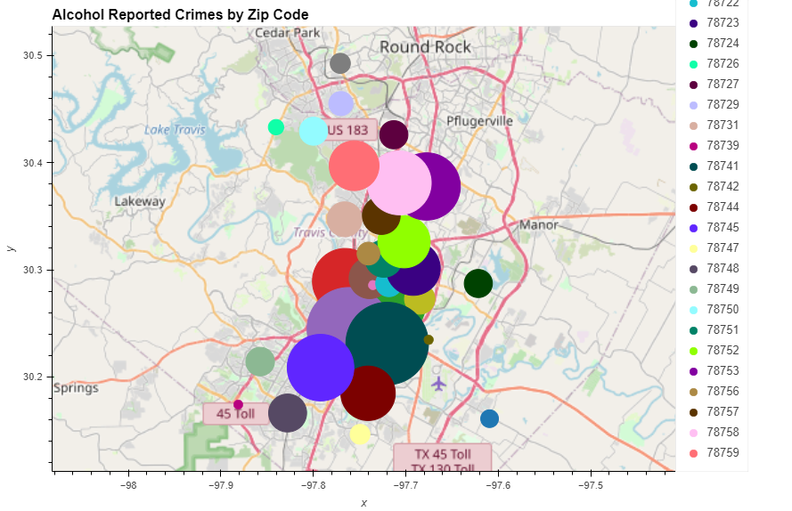

Slide 19
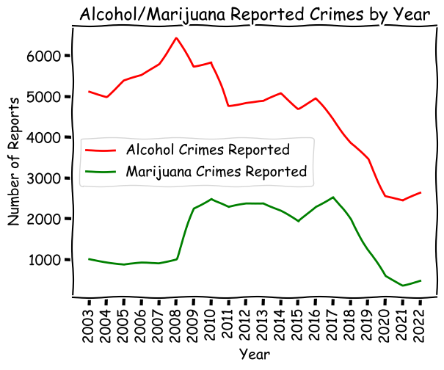

Slide 20
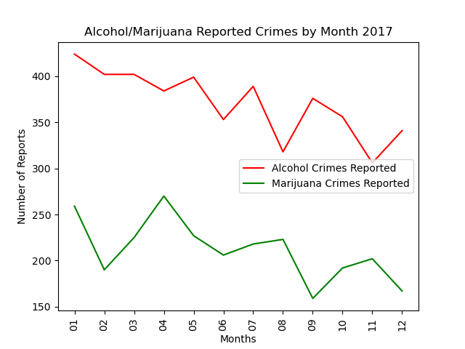
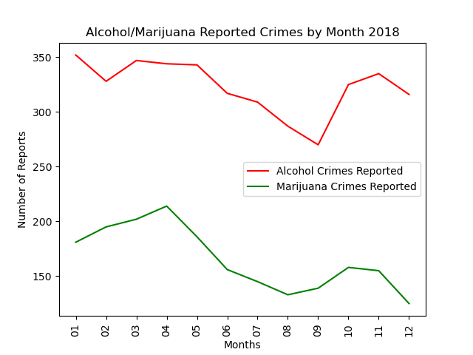
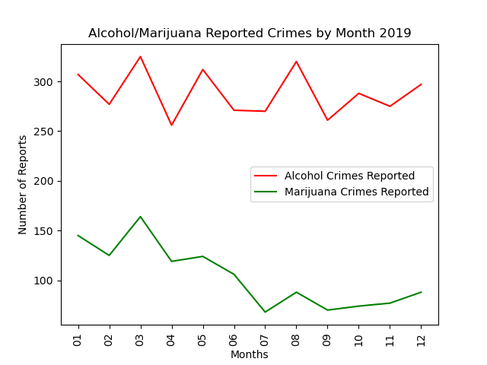
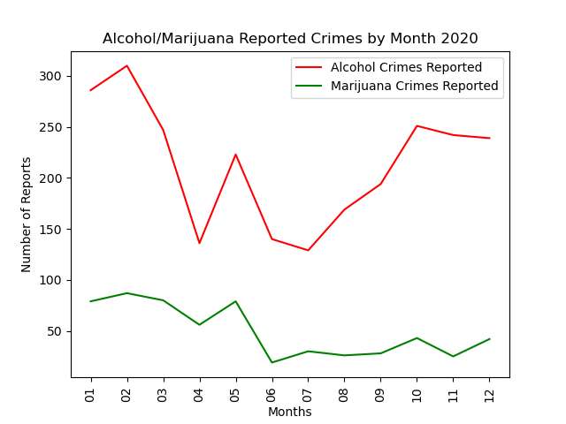
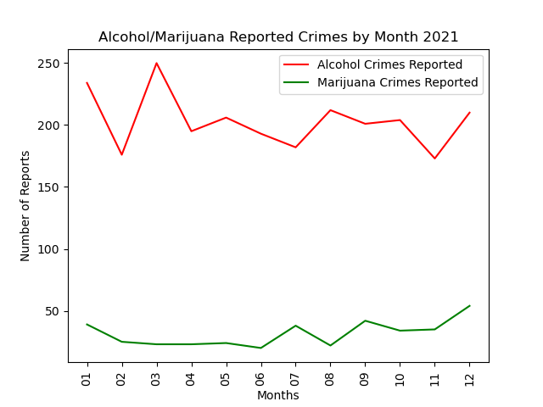
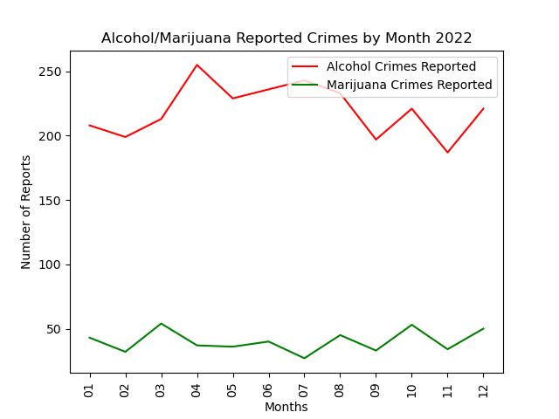
Alcohol & Marijuana Reported Crimes 2017 -2022

Slide 21

Major Findings

Slide 22
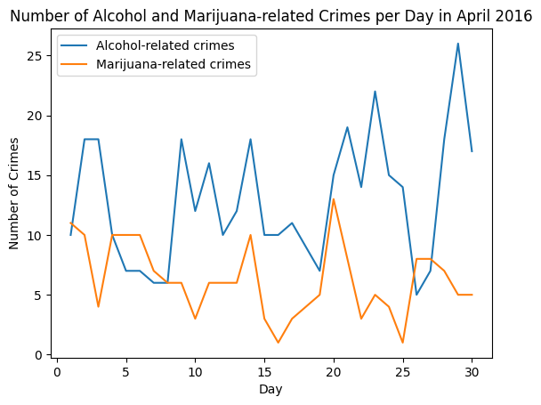
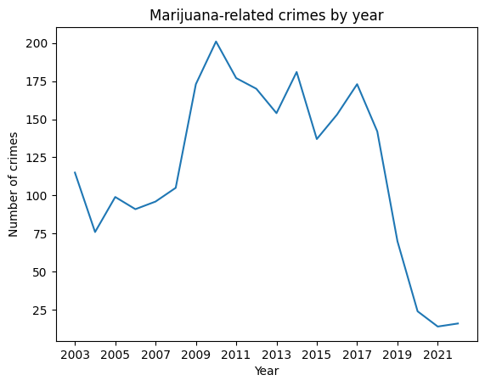
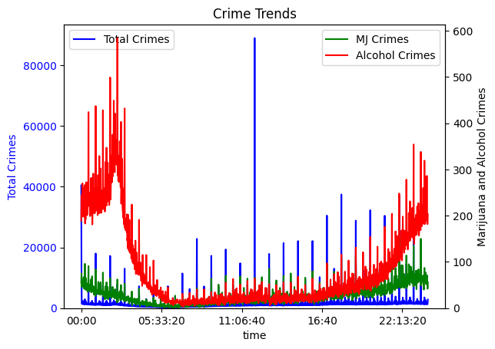
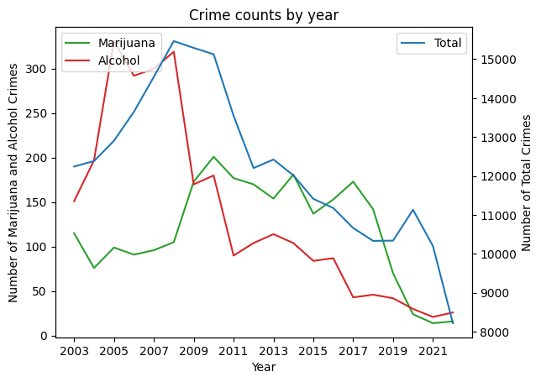
Some
Conclusive Insights…

Slide 23
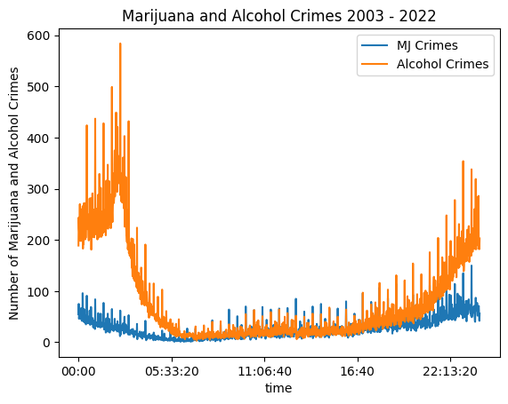
Alcohol & Marijuana Reported Crimes 2003 -2022

Slide 24

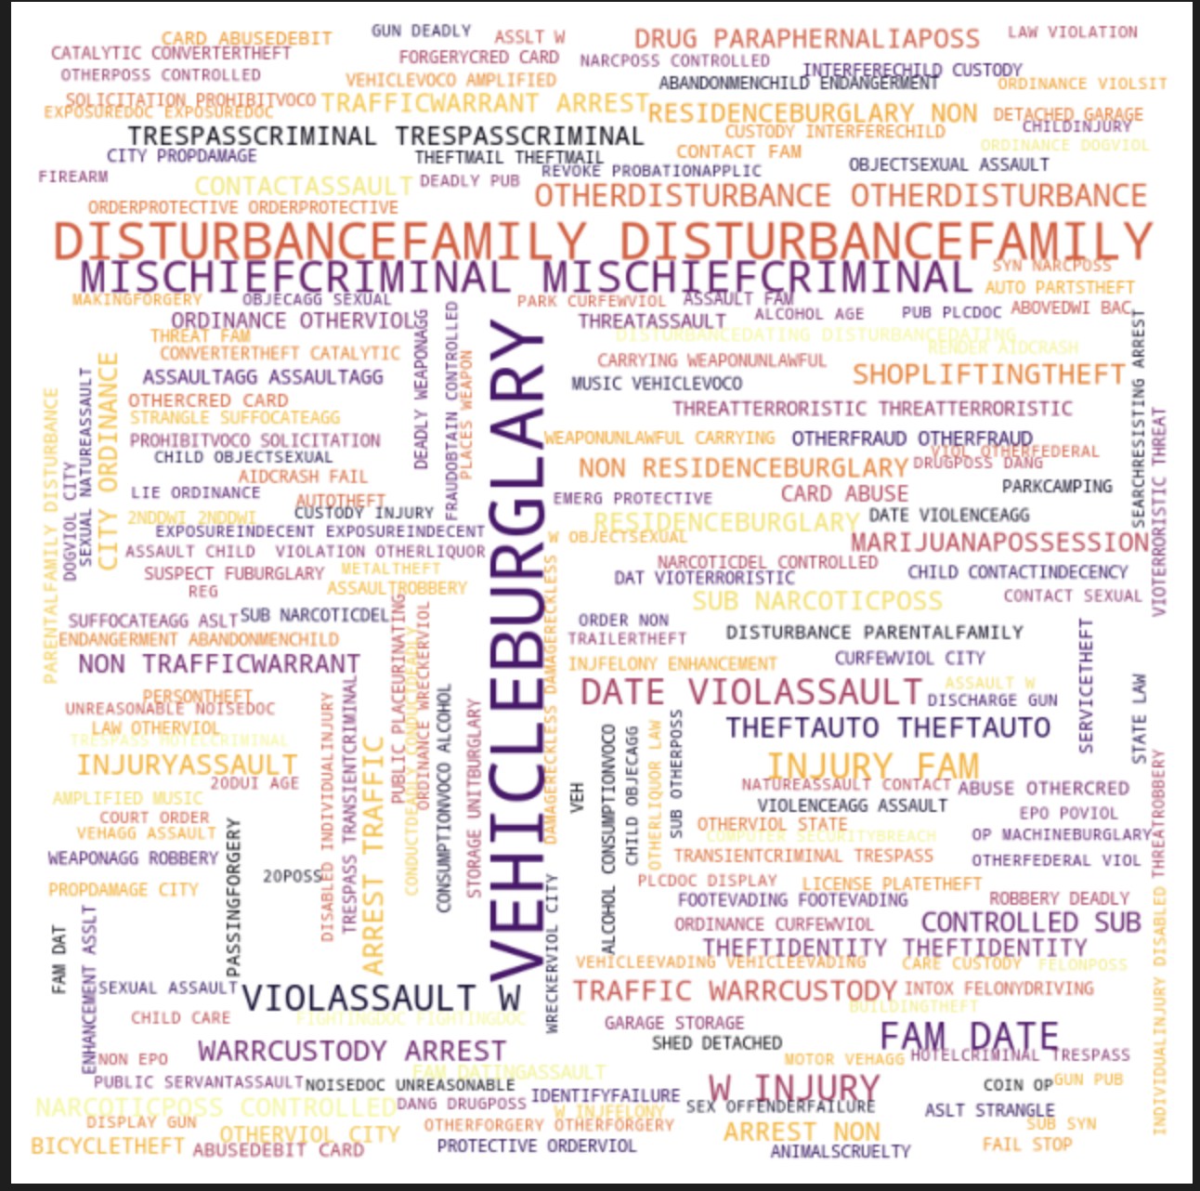
WOW.

